Slide 1
Sales Dataset Analysis – Advanced Excel Project
Presented by Mihala Nasrin P A
19/05/2025
DADS

Slide 2
Project Overview and Objective
To analyze the data for better understanding of trend, key performance indicators
Identifying what are the things that contributes in achieving great sales results
Creating a dashboard for easy understanding

Slide 3
Data Description and Preparation
Initially the data had 20 columns and 9994 rows
After removing the index column and duplicate data, added adjusted sales column, it have 20 columns and 9986 rows
The datas like date, sales have been for formatted and data validation have been applied.

Slide 4
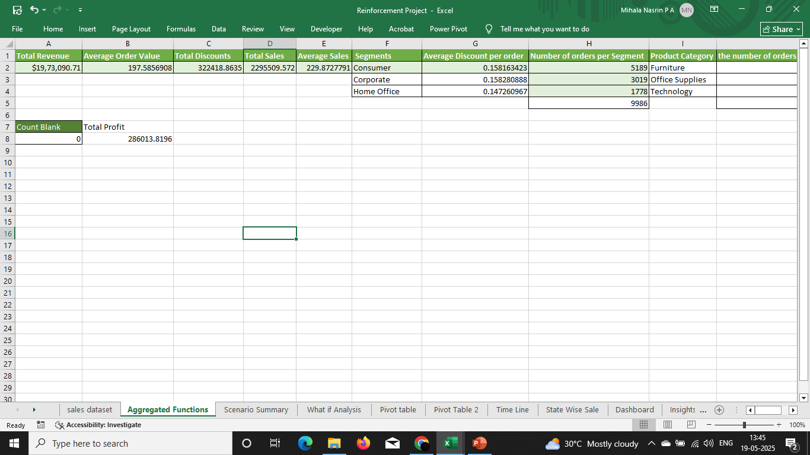
Key Metrics Calculation and Data Analysis
Using aggregated functions Key metrics like total revenue, profit .. Have been calculated.

Slide 5
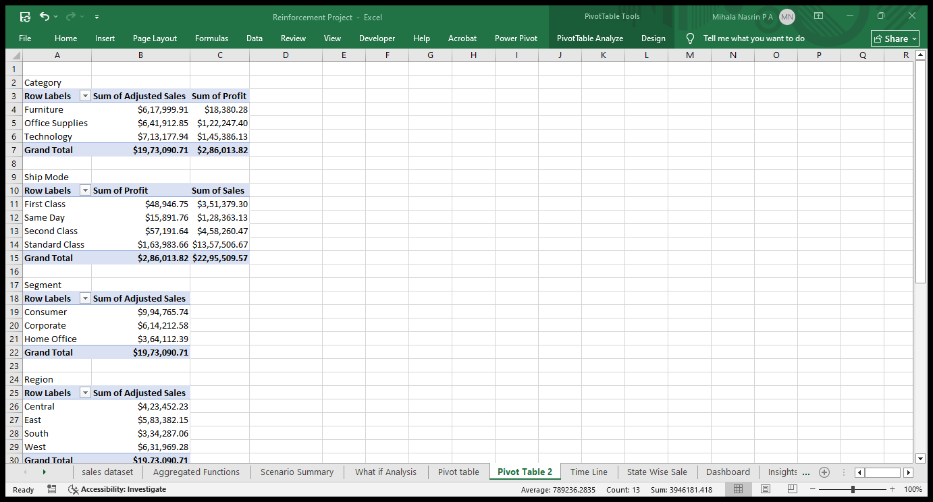
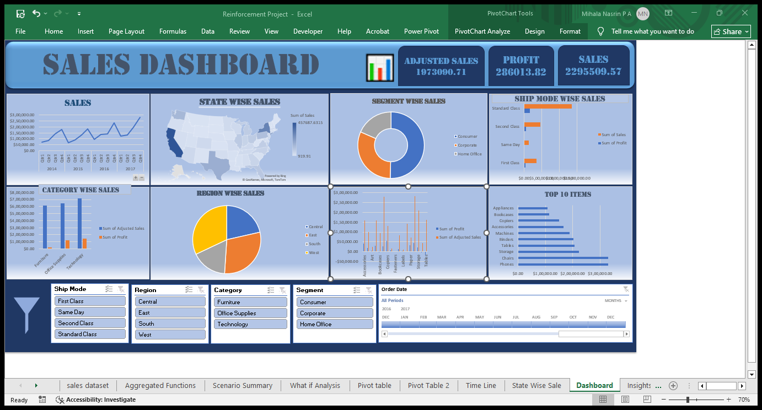
Pivot Tables and Pivot Charts
Pivot tables and pivot charts are used to understand the data better and do the calculations easier.

Slide 6
Dashboard Overview
Dashboard is used to make the data more presentable and to understand it better.
KPIs like sales, Profit are used.

Slide 7
Insights
The Insights are concluded using charts and dashboard.
As the years goes by the sales also increases.
Standard ship mode contribute the most sales among ship mode.
When it comes to segments consumer gives the highest sales.
4th quarter shows highest sales among the others.
West Region contributes the most among the region.
Technology have the highest sales among category

Slide 8
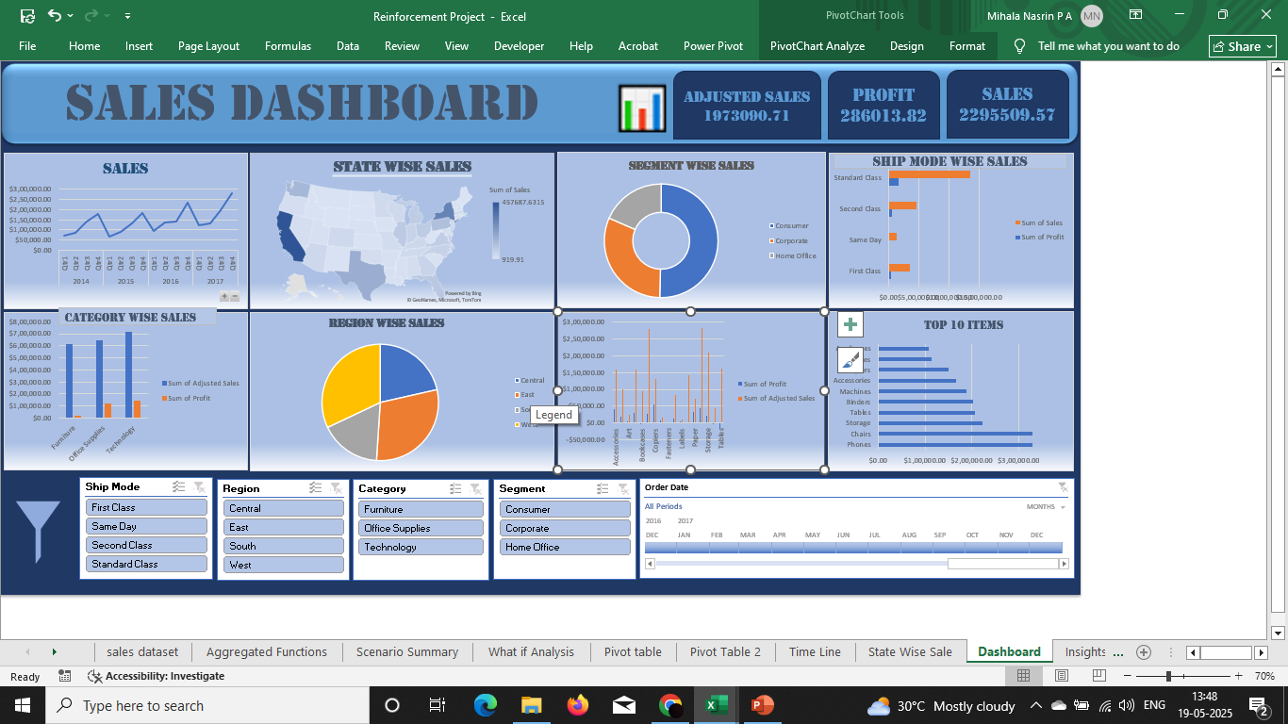

Slide 9
Recommendation
Decreasing discount will helps in increasing the profit and sales.
Promoting the region like west and east will also increase the sales.
Concentrating on top 10 products will be giving higher sales

Slide 10
Question

Slide 11
THANK YOU

